Slide 1
Empowering and inspiring Courts and communities to deliver transformative justice.

Slide 2
what is watcp?
WATCP is a professional organization representing the interests of problem solving courts in the State of Wisconsin.
The Association is governed by Board of 22 multidisciplinary Directors elected by the Membership
The multidisciplinary membership includes judges, prosecutors, defense attorneys, court administrators, treatment providers, probation and community corrections officers, law enforcement, social service caseworkers, state stakeholders, and other professionals in the field of treatment courts.
Notes:
Emily

Slide 3
What are Problem-Solving Courts?
The problem-solving court approach has been rapidly growing throughout the justice system.
The most commonly known types of problem-solving courts are drug treatment courts and OWI courts, but a wide range of other specialty courts, such as mental health, juvenile, domestic violence, tribal healing to wellness, and veterans courts are also used to address underlying issues related to a participant's criminal behavior, substance use and mental health.
Problem-solving courts work across disciplines and with other institutions to use interventions that treat the offender, while also holding them accountable for their criminal actions.
Notes:
Emily

Slide 4
WHAT IS A DRUG COURT?
A specially designed court calendar or docket, the purposes of which are to achieve a reduction in recidivism and substance abuse among nonviolent substance abusing offenders and to increase the offender’s likelihood of successful habilitation through early, continuous, and intense judicially supervised treatment, mandatory periodic drug testing, community supervision, and use of appropriate sanctions and other rehabilitation services (Bureau of Justice Assistance, 2005).
Notes:
Emily

Slide 5
The drug court Team
Judge
Prosecutor
Defense Attorney
Treatment Provider
Probation Agent
Law Enforcement
Coordinator
Some courts might also include:
Peer Support Specialist
Psychiatry
Medical Doctor
Recovery Coach
Drug Court Alumni

Slide 6
Drug Court Participants are
Provided with intensive treatment and other services they require to achieve sobriety and become productive members of society
Held accountable by the Drug Court judge for meeting their obligations to the court, society, themselves and their families
Regularly and randomly tested for substance use
Required to appear in court frequently so that the judge may review their progress
Rewarded for doing well or sanctioned when they do not meet the minimum requirements of the drug court program.
Notes:
Emily

Slide 7
The Drug Court movement
First drug court founded in Miami Dade County, Florida in 1989
First drug court started in Dane County, Wisconsin in 1996
The Ten Key Components of Drug Courts were published in 1997¹
National Association of Drug Court Professionals published Adult Drug Court Best Practice Standards Volume I in 2013²
Wisconsin Association of Treatment Court Professionals published Volume 1 of the Wisconsin Treatment Court Standards in 2014.
The draft of Volume 2 of the Wisconsin Treatment Court Standards is in the process of review and will be finalized in the fall of 2018³
1 http://www.ndci.org/sites/default/files/nadcp/Key_Components.pdf
2 http://www.nadcp.org/sites/default/files/nadcp/AdultDrugCourtBestPracticeStandards.pdf
3 http://www.watcp.org/wp-content/uploads/2014/04/WATCP_Standards_April-2014.pdf
Notes:
Emily

Slide 8
Problem-solving courts in Wisconsin
As of April 2018, Wisconsin has 85 operational problem-solving courts:
35 Drug Courts
17 OWI Courts
10 Veterans Treatment Courts
12 Hybrid OWI/Drug Courts
4 Mental Health Courts
4 Tribal Healing to Wellness Courts
3 Family Dependency Courts
*Any courts currently being planned but are not operational are not included in this count.
Notes:
Katy

Slide 9
Notes:
Katy

Slide 10
Problem-solving court funding & sustainability
Local financial support
County funding (tax levy, county board support)
Service Organizations (Lions Clubs, VFW, Knights of Columbus, etc)
501c3 organizations
Participant fees
State funding
Wisconsin Department of Justice
Treatment Alternative and Diversion Program
Wisconsin Highway Traffic Safety Office
Funds training for OWI Courts
Federal funding
Substance Abuse and Mental Health Services Association (SAMHSA)
Bureau of Justice and Information Administration (BJIA) Adult Drug Court Grants
National Highway Traffic Safety Office (NHTSA)
Notes:
Katy

Slide 11
Treatment Alternatives and Diversion (TAD)
Enacted through 2005 WI Act 25 to support county efforts that provide treatment and diversion programs for non-violent adult offenders for whom substance abuse was a contributing factor in their criminal activity
Projects began on January 1, 2007
Focus on treatment courts and diversion programs
Funded programs address public safety and reducing costs, jail/prison population, and recidivism
Programs must demonstrate the use of evidence-based practices
Notes:
Katy

Slide 12
TAD Expansion
From 2007-2013, the TAD program was funded at approximately $1 million, and included 9 county sites
In 2014, the TAD program was expanded by $3 million, and increased to 36 county and tribal sites
For calendar year 2018, the TAD program has been further increased to a total of almost $6.5 million, and now funds projects in 51 counties and 2 tribes
Notes:
Katy

Slide 13
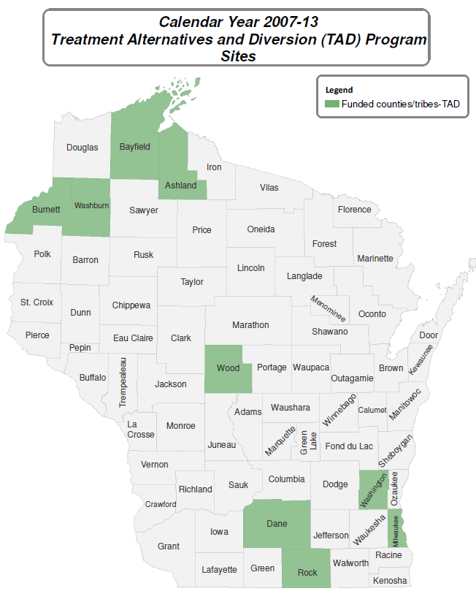
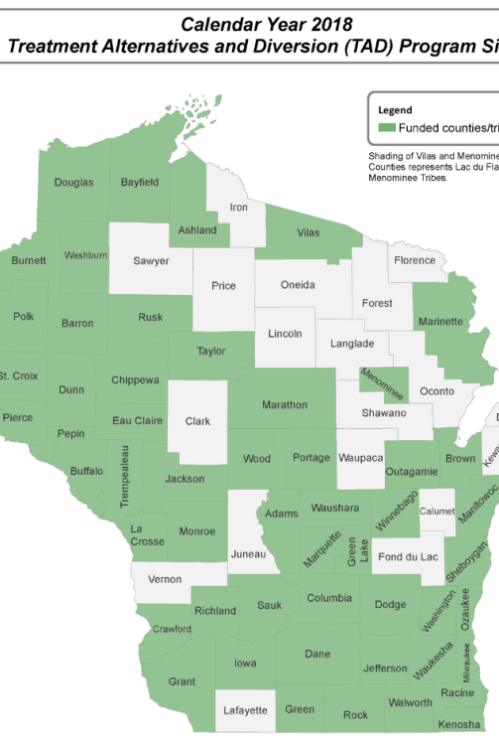
Tad expansion
Notes:
Katy

Slide 14
10 Key Components of a drug court
Drug courts integrate alcohol and other drug treatment services with justice system case processing
Using a non-adversarial approach, prosecution and defense counsel promote public safety while protecting participants’ due process rights
Eligible participants are identified early and promptly placed in the drug court program
Drug courts provide access to a continuum of alcohol, drug, and other related treatment and rehabilitation services
Abstinence is monitored by frequent alcohol and other drug testing

Slide 15
10 Key components of a drug court
A coordinated strategy governs drug court responses to participants’ compliance
Ongoing judicial interaction with each drug court participant is essential
Monitoring and evaluation measure the achievement of program goals and gauge effectiveness
Continuing interdisciplinary education promotes effective drug court planning, implementation, and operations
Forging partnerships among drug courts, public agencies, and community-based organizations generates local support and enhances drug court program effectiveness
Notes:
Emily

Slide 16
Component #1: Integrate Substance use treatment services with justice system case processing
Drug courts use a team approach to promote recovery through a coordinated response to offenders with a substance use disorder
Collaboration of judges, prosecutors, defense counsel, probation authorities, other corrections personnel, law enforcement, pretrial services, local service providers, and the community
Drug courts employ a multi-phased treatment process
Notes:
Emily

Slide 17
Component #2: non-adversarial approach
The prosecutor and defense counsel must shed their traditional adversarial courtroom relationship and work together as a team
Prosecutors and defense counsel participate in the design of screening, eligibility, and case-processing policies and procedures to guarantee due process rights and public safety needs are served
Notes:
Emily

Slide 18
Component #3: eligibility
Eligible participants are identified early and promptly and placed in the drug court program
Eligibility criteria is based on established written criteria
A participant’s initial appearance before the drug court judge occurs immediately after arrest or apprehension
Notes:
Emily

Slide 19
Component #4: Access to continuum of Substance use treatment and rehabilitation services
The therapeutic team (judge, treatment providers, lawyers, case managers, and supervisors) maintains frequent, regular communication to provide timely reporting of a participant’s progress and to insure timely responses to compliance and noncompliance
The drug court team must consider co-occurring factors such as mental illness, homelessness, medical problems, unemployment to insure proper linkages to address these needs
Treatment services must be accessible
Treatment services must be compliant with federal and state regulations

Slide 20
Component #5: drug testing
Abstinence is monitored by random and frequent alcohol and other drug testing
Testing occurs no less than twice a week in drug court
Testing policies and procedures are based on established and tested guidelines
Directly observed
Verification of temperature and measurement of creatinine levels
Specific, written procedures for all aspects of urine sample collection, analysis, and result reporting
Documented chain of custody for each sample
Results are generally available within 24 hours
Notes:
Emily

Slide 21
Component #6: Coordinated Response to Participant Compliance
The Court team maintains regular and frequent communication
Reporting of progress for compliance and noncompliance is timely and the court responds immediately
The Court team establishes a coordinated strategy, including a continuum of responses, to continuing drug use and other noncompliance behavior
Responses to compliance and noncompliance are provided to the participant both verbally and in writing before orientation to emphasize predictability, certainty and swiftness of their application
Notes:
Katy

Slide 22
Component #7: The role of the Judge
The judge’s role as leader is paramount to the success of the program. They must possess recognizable leadership skills as well as the capability to motivate team members and elicit buy-in from various stakeholders.
The selection of the judge to lead the problem-solving court team, therefore, is of utmost importance.
The judge conducts regular status hearings to monitor participant performance
Notes:
Katy

Slide 23
Component #8: evaluation
Drug Courts must have clearly defined and measurable program goals
Goals should be described concretely and in measurable terms to provide accountability to funders and policymakers
Drug courts should plan for process and outcome evaluations to assess the program’s effectiveness
Notes:
Katy

Slide 24
Component #9: Training
Ongoing education ensures the drug court’s goals and objectives are understood by team members and managers
Team members should receive 40 hours of training per year
WATCP Provides two annual training conferences to provide continuing education of drug court team members
Statewide Spring Conference – over 500 participants
Statewide Fall Coordinator Conference – over 100 Coordinators, case managers, and Treatment providers
Combination of National and State professionals provide relevant subject matter
Notes:
Katy

Slide 25
Component #10: Community outreach
Drug court team members should engage in activities to build partnerships that will improve outcomes, support the drug court and ensure the best interests of the community are considered
The drug court should forge partnerships and linkages among drug courts, public agencies, and community-based organizations to generate local support
Notes:
Katy

Slide 26
Treatment Court Standards
National Association of Drug Court Professionals (NADCP) has developed standards for operating Treatment Courts that follow Evidence Based Practices
Volume I (2013)
Volume II (2015)
Wisconsin Association of Treatment Court Professionals (WATCP) Standards
WATCP Standards (2014)
Revised Standards Coming Soon (2018)
Notes:
Emily

Slide 27
State Resources for Problem-solving courts
Statewide Problem-Solving Court Coordinator, Office of Court Operations: Katy Burke Ph: 608-266-886, katy.burke@wicourts.gov
Special Projects Coordinator, Office of the Director of State Courts: Tommy Gubbin, Ph: 608‐261‐0864, tommy.gubbin@wicourts.gov
Justice System Improvement Specialist, Wisconsin Department of Justice, Justice Programs Section : Reneé Lushaj, Ph: 608-266-7864, lushajrg@doj.state.wi.us
State Criminal Justice Coordinating Council (CJCC) https://cjcc.doj.wi.gov
Search current treatment court and diversion programs https://cjcc.doj.wi.gov/local-program-map
Wisconsin Association of Treatment Court Professionals www.watcp.org
WATCP Treatment Court Coordinator Conference – September 19-20th Holiday Inn and Resort Stevens Point, WI
WATCP State Treatment Court Conference -Spring 2019
Wisconsin Treatment Court Standards
Wisconsin Epidemiological Profile on Alcohol and Other Drugs, 2016 https://www.dhs.wisconsin.gov/publications/p4/p45718-16.pdf
Wisconsin State Council on Alcohol and Other Drug Abuse Prevention Committee
June 2016 Research-Based Review and Recommendations for Reducing the Public Health Impact of Marijuana https://scaoda.wisconsin.gov/scfiles/marijuana/marijuana-072216.pdf
Notes:
Katy

Slide 28
National resources for problem-solving courts
National Association of Drug Court Professionals www.nadcp.org
Annual National Conference
FREE resources (pdf documents)
Volume I and II of the Adult Drug Court Best Practice Standards
National Drug Court Institute www.ndci.org
FREE webinars, request onsite training and/or technical assistance
Training opportunities for courts in different phases of development, role specific webinars and publications
The Drug Court Judicial Bench Book http://www.ndci.org/sites/default/files/nadcp/14146_NDCI_Benchbook_v6.pdf
Center for Court Innovation www.courtinnovation.org
National Center for State Courts www.ncsc.org
National Rural Institute on Alcohol and Drug Abuse www.uwstout.edu/profed/nri
National Center for DWI Courts www.dwicourts.org
Substance Abuse Mental Health Services Administration www.samhsa.org
Information regarding CLIA
https://wwwn.cdc.gov/clia/resources/waivedtests/pdf/15_255581-A_Stang_RST_Booklet_508Final.pdf
Notes:
Katy

Slide 29
Thank you!

Slide 30
Katy Burke, CSAC
Statewide Problem-Solving Court Coordinator
Wisconsin Supreme Court, Office of Court Operations
Katy.burke@wicourts.gov
(608) 266-8861
Attorney Emily Nolan-Plutchak
Assistant State Public Defender
Wood County Drug Court Team Member
Nolan-plutchake@opd.wi.gov
(715) 345-5387

